Slide 1
Static Code Analyzer
Name: Kamruzzaman Asif
Roll: BSSE 1217
Supervisor Name: Dr. Kazi Muheymin-Us-Sakib

Slide 2
Table of Contents
01. Project Description
02. Motivation
03. Working Methodology
04. Technology
05. Progress
06. Further Plan
07. Challenges

Slide 3
Project Description
1

Slide 4
Project Description
This will be a software tool that will analyze the C source code and will show the metrics(such as LOC, Halstead) and will be able to detect clones.

Slide 5
Motivation
2

Slide 6
Motivation
Static analysis is widely used in software engineering by software development and quality assurance teams. Software developers should use static code analysis for a better understanding of the software, code simplification and sanitizing, identifying potential bugs, coding standards, improving application performance, better resource utilization, etc.

Slide 7
Working Methodology
3

Slide 8
Working Methodology
Overview of Full Process
Generate Metrics
A directory
containing
files
Read files
Show result
Detect clones

Slide 9
Working Methodology
LOC Metrics
1. Physical Lines of Code
2. Logical Lines of Code
3. Comment Lines
Source
Code
Preprocessing &
String Manipulation
LOC Metrics

Slide 10
Working Methodology
Halstead Metrics
Preprocessing
>Removal of Blank Lines, Comments, Extra spaces, Function declarations and
Hash directives
Source
Code
Tokenization
Halstead Metrics

Slide 11
Working Methodology
Halstead Metrics
the number of distinct operators(n1)
the number of distinct operands(n2)
the total number of operators(N1)
the total number of operands(N2)
Halstead Measures
Program vocabulary : n = n1+n2
Program length : N=N1+N2
Calculated program length : _N = n1*log(2)n1 + n2*log(2)n2
Volume : V= N * log(2)n
Difficulty : D = n1/2 * N2/n2
Effort : E = D * V
Time Required To Program : T = E/18 seconds
Number of delivered bugs : B = E^(2/3) / 3000 or B =V/3000

Slide 12
Working Methodology
Clone Detection
Source
Code
Generate K-grams of file
Hashing to get has values
Winnowing Algorithm
Comparison of fingerprints using Statistical methods(such as Jaccard
Similarity and Dice similarity coefficient)
Get result
Fingerprinting

Slide 13
Technology
4

Slide 14


Technology

Slide 15
Progress
5

Slide 16
Progress
Metrics
LOC Metrics
Halstead Metrics

Slide 17
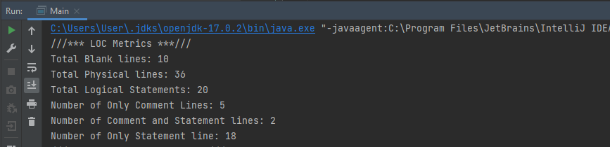
Progress
LOC Metrics

Slide 18
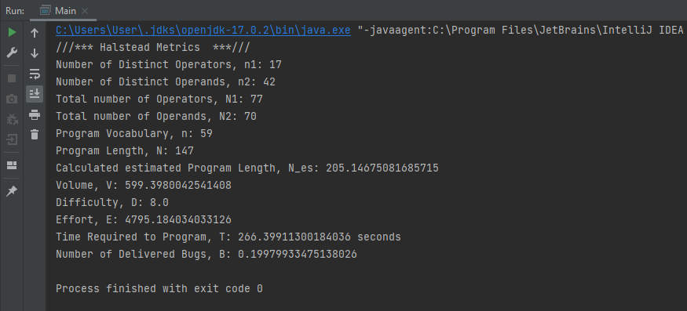
Progress
Halstead Metrics

Slide 19
Further Plan
6

Slide 20
Further Plan
Clone Detection
Hashing
Implementation of Winnowing Algorithm
Fingerprinting
Jaccard similarity & Dice similarity coefficient
GUI
Try to add a simple GUI using JavaFX

Slide 21
Challenges
7

Slide 22
Challenges
Challenges so far:
First time working on a big project
Preprocessing and other manipulation of code
Tokenization of source code
Further challenges:
Learning about the implementation of winnowing algorithm
Learning about hashing, fingerprinting
Leaning statistical analysis (Jaccard similarity, Dice similarity coefficient)

Slide 23
Thank You
GitHub repository: https://github.com/KamruzzamanAsif/SPL-1

